Slide 1
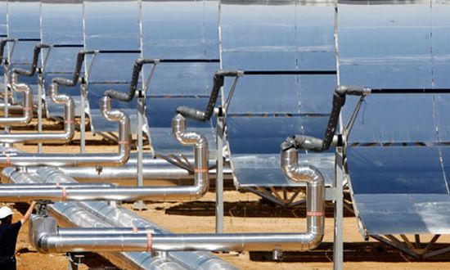
HYBRID RENEWABLE THERMAL ENERGY

Slide 2
Expertise
Richard Battaglia: Director Engineering
Recovered Energy Group
35 Years Of Proven Project Management In Independent Electric Power Generation Using Advanced Gas Turbines, Electric Generators & Steam Turbine Generators.
BUILDING OF NEW HYBRID ELECTRIC POWER GENERATION PLANTS
EQUIPMENT ASSET OPERATIONS MANAGEMENT
ASSET MAINTENANCE MANAGEMENT

Slide 3
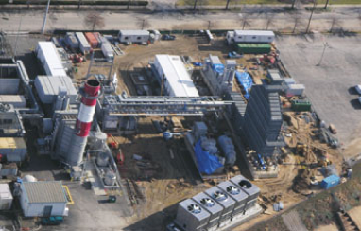
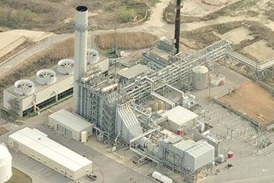
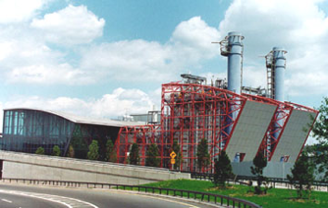
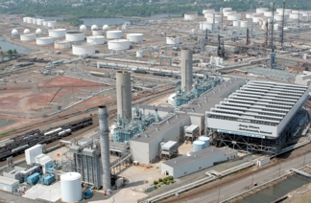
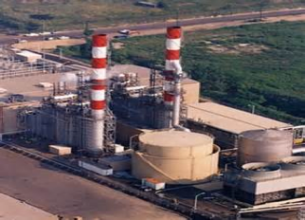
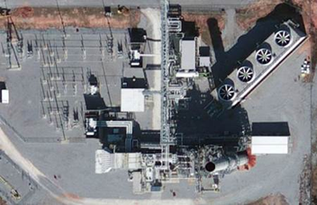
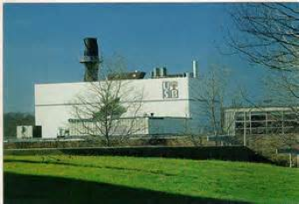
Past Projects 50 to 750 Megawatts
BETHPAGE I & II
BETHPAGE III
HOG BAYOU
JFK AIRPORT
LINDEN BAY
NEWARK BAY
SANATA ROSA
STONY BROOK

Slide 4
RECOVERED ENERGY GROUP
RECOVERED ENERGY TYPES OF HYBRIDS
HYBRID ELECTRIC POWER GENERATION
HYBRID CYCLE HEAT RECOVERY TO ELECTRIC
HYBRID COMBINATION HEAT WITH ELECTRIC
HYBRID SOLAR THERMAL STEAM CYCLE
HYBRID IN GAS FIRED COMBINED CYCLE
WASTE-TO-ENERGY - GAS TURBINE HYBRID CYCLE
OFFERING HYBRID ELECTRIC POWER GENERATION

Slide 5
Why The Hybrid WTE Option?
Definition of Hybrid Plants;
“Combining of the Best”
A Hybrid Optimized Combined Cycle Waste To Energy Plant uses a Gas Turbine with a Waste Heat Recovery Boiler, in a Combined Steam Cycle with a WTE Steam Plant Cycle.
Hybrid Electric Plants Are More Efficient and More Cost Effective to Build, To Operate and To Maintain Than Conventional Simple Cycle Steam Electric Power Plants.
Hybrid Waste To Energy Plants Are More Efficient than Simple Cycle Gas Fired and Simple Cycle WTE Plants.

Slide 6
HYBRID RENEWABLE ENERGY
Modern gas-fired power plants employ industrial gas (combustion) turbine engines similar to the gas turbines utilized to provide propulsion to modern aircraft.
Combined Cycle gas-fired power plants, which use the turbine’s exhaust heat to generate additional electricity or to supply process steam, cost far less half as much to construct as coal-fired plants and emit half the greenhouse gases.
Simple Cycle gas-fired power plants are less efficient than Combined Cycle plants. They are kept in standby and just for electric grid peak shaving.
Hybrid Renewable Energy Centers Integrate Waste to Energy & Concentrated Solar Power Steam With Modern Combined Cycle gas-fired power plants.

Slide 7
CONVENTIONAL WTE PLANT
Conventional Waste To Energy Plant Uses Simple Cycle Steam Cycle from Mass Burn Boiler.
Typical Mass Burn Boiler Steam Cycle Plant has a low 25 % Efficient, Far Less than that of Conventional Simple Cycle Coal, Gas or Oil Fired Electric Thermal Electric Plant. Conventional Thermal Electric Power Plants have a 30 – 35 % Steam to Electric Power Plant Cycle Efficiency.
Conventional WTE Primary Fuel is Municipal Solid Waste. A Startup Assist Fuel, Fuel Oil, Natural Gas or Coal, is Required.

Slide 8
MASS BURN WTE PLANT

Slide 9
COMBINED CYCLE GT PLANT
Combined Cycle Natural Gas Fired, LNG to NG Or Fuel Oil Fired Power Plant Is a Hybrid Electric Power Generation Plant Combining Two or More Steam Cycles.
Combined Cycle Gas Turbine Engine Electric Power Generation Plants Utilize Medium to Large Combustion Turbine Engines and Medium to Large Steam Turbine Engines.
Gas Turbine & Steam Turbine Combined Cycle Electric Power Plants are the Most Efficient Electric Power Generation Plants with Efficiencies of 40 Percent to 60 Percent or Greater Efficiencies.

Slide 10
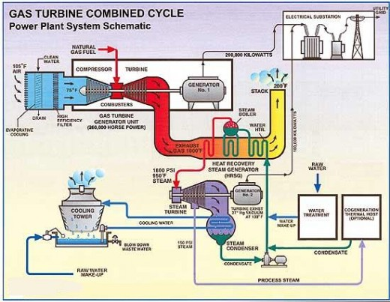
COMBINED CYCLE - GAS FIRED
COMBINE CYCLE ELECTRIC POWER PLANT

Slide 11
HYBRID GTG & WTE PLANT
The Hybrid Gas Turbine Electric Generator and Waste to Energy Electric Generator Power Plant Combines the Best of Both Electric Power Plant Systems in Two Combined Electric Power Production Cycles.
The Resulting Hybrid GTEG & WTE Electric Power Plant Has Combined Cycle Net Electric Efficiency In Excess of Forty - Four Percent, 44 %, While Providing a True Dual Fuel Electric Power Generation Energy Center.
The Hybrid GTG & WTE Electric Power Plant May Operate in Combined Cycle or in Separate Simple Cycle.

Slide 12
HYBRID GT & WTE OCC PLANT

Slide 13
OPTIMUM GAS &WASTE PLANT

Slide 14
HYBRID WTE OCC PLANT
Overview Of The Hybrid Optimized Combined Cycle – WTE
A Hybrid Waste to Energy plant, near Bilbao, in Spain, is a Conventional Grate Incinerator with an Advanced Energy Recovery System.
The WTE plant is Combined with a Natural Gas Fired Power Plant; Steam Produced by the Waste Heat Recovery Boiler is Used within a Combined Cycle Gas Turbine (CCGT) Process, Resulting in a Considerably Higher Electrical Efficiency.
Increased Efficiency of 20% is Possible Due to the External Superheating of the Steam to Temperatures Beyond that Possible in a Conventional Waste To Energy Power Plant.

Slide 15
HYBRID GAS WTE PLANT
The WTE segment of the plant consists of a single combustion line rated at 30 tons per hour, capable of treating up to approximately 250,000 tons of MSW Per Year. The plant recovers close to 800 kWh of electrical energy from each ton of MSW, this is a 20% efficiency improvement gain than that of a conventional stand-alone WTEs of the same size.
The GT generator portion of the plant consists of a 43 MW Natural Gas Turbine Generator. An Additional 56 MW is Generated through a shared Steam Turbine Electric Generator.
The combined electrical output of the plant is a net output of 95MW, at a Combined Net Efficiency Rating of 42%.
The Hot Exhaust Gases from the Gas Turbine Generator are Used to Raise the Temperature of the WTE Steam to Greater than would be possible in a standard WTE Steam Cycle.

Slide 16
HYBRID CTCC GAS & SOLAR
The Hybrid Combined Cycle Gas Turbine Electric Generator(s) with Steam Turbine Electric Generator(s) and Utilizing a Concentrated Solar Trough Steam to Electric Cycle offers Greater Efficiencies than a Conventional Gas Fired Combined Cycle Gas Turbine and a Steam Turbine.
Electric Power Plant with Hybrid ISCC Net Electric Power Plant Efficiencies Beginning at Fifty Percent, 50% and exceeding Sixty – Five Percent , 65+%.
ISCC Electric Power Plants Support Greater Hybrid Combined Cycle Power Plant Electric Output During Much of the Daily On Peak Day Time Periods.

Slide 17
HYBRID GAS & SOLAR PLANTS
FPL’s Martin Next-Generation Hybrid Combined Cycle Gas Turbine - Solar Energy Center connects a field of solar thermal mirrors with an existing combined-cycle natural gas power plant

Slide 18
SOLAR NATURAL GAS HYBRID
CSP is Best Suited to a Gas Turbine To Waste Heat Recovery Hybrid, Both Systems Produce Shared Heat With A Combined Shared Steam Turbine and Condenser.
The Design Goal is to Integrate the Largest Possible Solar Field.
Economics and The Maximum Available Solar Resource are the Key Drivers in the Design.

Slide 19
Hybrid Combined Cycle Solar GTG
Hybrid Combined Cycle Gas Turbine CSP Design Involves a large CSP Solar Collection Field in Parallel with one or more Gas Turbine Electric Generators in a Combined Shared Integrated Recovered Waste Heat To Steam Cycle.
The Gas Turbine Electric Generator is essentially a large jet engine turning a generator may be brought into operation very quickly. Rapid Ramp Rates, Ideal for Use with a Solar Thermal Electric Power Installation, which electric power output may be ramped up or ramped down due to No Solar Electric Power during Night Time Hours.
Combined Cycle Gas Turbine Electric Generators are More Effective for Continuous Term usage, producing large amounts of electricity over long periods of time.

Slide 20
HYBRID GAS & SOLAR PLANT
Kuryamat ISCC Power Plant Egypt is located at 90 km S of Cairo, on the Nile, Giza, in Egypt.

Slide 21
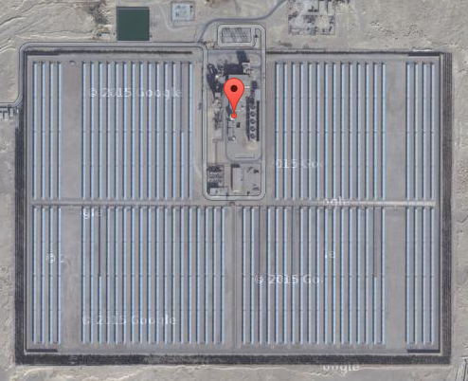
HYBRID GAS & SOLAR PLANT
An Integrated Gas & Solar Energy Hybrid Plant was Built in 2009, in 2010 and commissioned, in 2011.
A Twenty Four Megawatt Addition of Concentrated Solar Electric Power Production was combined in to the Kuryamat Gas Fired Combined Cycle from the beginning of the concept. .

Slide 22
Flexible Fuel Combustion Diversity
Fuel Flexibility is Essential to Power Plant Economics.
70 Percent of All Electric Power Generation Expenditures are fuel related. Fuel is the Most Expensive Commodity.
15 Percent of All Electric Power Plant Expenditures are Capital Expenses.
10 – 15 Percent of all Electric Power Plant Expenditures are for Power Plant Operations Labor Expenses and for ongoing Routine Minor and Major Maintenance Labor Expenses.

Slide 23
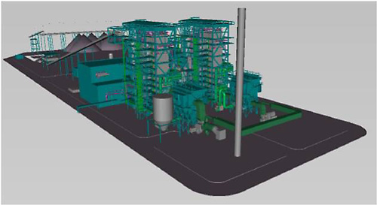
HYBRID WTE & COAL PLANT

Slide 24
WTE & COAL HYBRID - CFB

Slide 25
WTE & COAL ADVANTAGES
CFB – Circulating Fluidized Bed Combustion
Allows For Multiple Feed Stocks; COAL, Municipal Solid Wastes, Bio-Mass Based Feed Stocks; Wood, Wood Pellets
Cleaner Combustion Of All Types Of Solid Fuels
Lower Combustion Temperatures Results In Lower Plant Emissions.
CFB Boiler Power Plant Offers Alternative Feed Stocks, Allows For Lowest Power Plant Turndowns.

Slide 26
WTE HYBRID ADVANTAGES
HYBRID ELECTRIC POWER PLANTS TAKE ON MODERN ENERGY CYCLE CONFIGURATIONS
New Construction Hybrid GTG & WTE Power Plant Offers EARLY Gas Fired Gas Turbine Electric Generator Operations in less than half the time and prior to the full completion of WTE plant combined cycle construction.
Hybrid WTE Plant Continues to Operate During Single Feedstock, Single Fuel Curtailments, Fuel Interruptions.
Hybrid WTE Electric Power Provides Added Fuel Flexibility Without Electric Power Interruptions.

Slide 27
PALESTINE - RENEWABLE WTE
Palestine would Benefit from New Renewable WTE Electric Power Generation.
Renewable Fuel Feedstock Diversity is Fuel Flexibility.
Hybrid WTE Electric Power Plants Provide for Reductions to Existing Landfills while Eliminating New Landfills.
Hybrid WTE Electric Power Generation is the Best Use, The Efficient Use and Effective Use of All Available Renewable Resources.

Slide 28
WTE GLOBAL CONTRIBUTION
To Appreciate the Contribution of the Global WTE Industry to the Conservation of Fossil Fuels, it should be mentioned that the Energy WTE Generates Globally Reduces the Use of Coal by about 25 Million Tons Each Year.
This Environmental Benefit would be Increased Five-Fold, if these WTE Thermal Efficiency Improvements were to be Achieved Globally.
Efficiencies would Increase by another Factor of Ten if the MSW that is Now Going to Landfills were Combusted in Thermally Efficient Hybrid WTE Facilities.

